Slide 1
Code Structure
By Mair swartz

Slide 2
Agenda
Introductions
About this course
Admin scale
A design methodology (is, does, has)
Core principles
Express intent
Variable names
Keeping scope small
Structuring code
Where to start
Cache pattern
Config pattern
Refactoring, structure and folder composition
The governor
FreeRtos
Leaky abstractions
Persisting data
Thread safety with mutex

Slide 3
Webinar Etiquette
Please:
1. mute yourself if you are not talking
2. If possible, minimize background noise.
3. Its more interesting to see your face and it helps with communication.
4. Make sure you unmute yourself when you want to talk
5. Be interactive and ask questions

Slide 4
Introductions

Slide 5

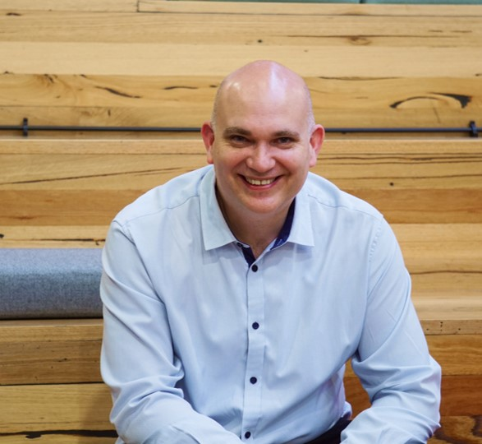
Who I am
Programming for 23 years
Studied heavy current at collage in South Africa
Computer Polyglot including
C
C++
C#
Rust
JavaScript
TypeScript
SQL
Multiple technologies including
Embedded engineering
Hardware design
Docker
React
SharePoint
I work for a Wi-Fi security startup called Hack Hunter

Slide 6
intRo
Who are you?
What do you do?
What do you hope to get out of this course?
Something you are interested in?

Slide 7
You are here to learn
This course assumes some basic knowledge on C and the IDF however….
If there is any concept you come across you don’t understand or need clarified, STOP ME AND ASK.
Don’t feel embarrassed to ask questions. You are here to learn and I am here to help you!

Slide 8
About this course

Slide 9
Sample Project
Should be simple enough to write in a couple of days
Should be complex enough to show aspects of the course
As hardware is not the topic, it should not be the focus

Slide 10
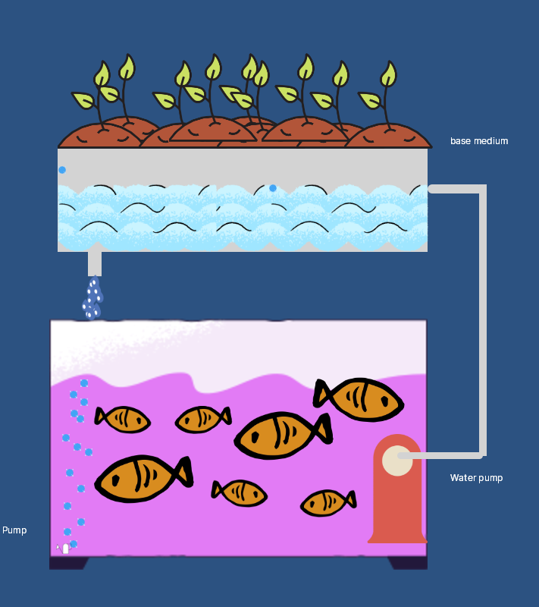
An aquaponics system
Ornamental or edible fish
Healthy, lush vegetables that grow very fast
Semi-closed ecosystem

Slide 11
Rough explanation of how the system works
Fish, plants and bacteria
Flood and drain
Bell siphon brief explanation: https://www.facebook.com/educationalgifss/videos/169272147027456/

Slide 12

How did we get here?
Proposal
Estimation
Design
Build
Test
Signoff
release
Waterfall
Plan
Design
Develop
Test
Deploy
Review
Agile

Slide 13
The admin scale
Goals
Goals
A scale for use which gives a sequence (and relative seniority) of subjects relating to organization
The scale is worked up and down UNTIL IT IS (EACH ITEM) IN FULL AGREEMENT WITH THE REMAINING ITEMS.
In short, for success, all the items must agree with all other items in the scale on the same subject
Purposes
Purposes
Policies
Compliance/Standards
Plans
Plans
Programs
Designs
Projects
Projects
Orders
Code
Ideal Scenes
Ideal Scenes
Statistics
Statistics
Valuable Final Product
Valuable Final Product
https://www.delphineryan.co.uk/the-admin-scale-tool#:~:text=The%20Admin%20Scale%20is%20a,goals%20%2C%20whatever%20these%20may%20be

Slide 14

Let’s discuss some project fails
Goals
Purposes
Policies
Plans
Programs
Projects
Orders
Ideal Scenes
Statistics
Valuable Final Product

Slide 15
Admin scale for aquaponics system
Goals
Grow healthy vegetables and fish efficiently
Purposes
Create an aquaponics system
Compliance/Standards
CFC compliant, Wi-Fi in range
Plans
Where to put it, installation, etc.
Designs
PCB design / code design
Projects
PCB Project / Firmware project
Code
code
Ideal scenes
Feedback and iteration
Statistics
Number of vegetables grown
Valuable Final Product
A safe and reliable aquaponics system

Slide 16
A design methodology
Is, does, has

Slide 17
What is it, What does it do, what does is have
Here is a method to help your design process
The following will fall under “design”
Some tips:
The purpose of doing a design is so that you are clear on what needs to be built. No more!
Design enough so that you can see the whole story and no more
You should not be afraid to change your designs. If you are, something is wrong!

Slide 18
What is it, What does it do, what does is have
What is it
Features
What does it do
Communications
What does it have
Hardware components
constraints
Sequence flow
Purpose
Constraints
Decisions
Constraints
Software components
Decisions
Process flow

Slide 19
Let’s play a little game
Person 1 Think about common household or office appliance.
Person 1 declares “is”, “does” or “has”
Person 2 asks questions about the appliance
Person 1 responds but is not allowed to say anything related to what he has chosen (is does, or has) but must substitute another selection to answer the question.
Bonus points: Person 1 substitutes answers with one of the following
Innovative
Transformative
Industry Leader
Engaging
Dynamic

Slide 20
Reviewing some high-level designs
Let’s see some high-level designs of our aquaponics system
I like flow diagrams and sequence diagrams
Design enough to get uncertainty out of your head and no more!

Slide 21
Design Decisions
How can we
Measure water depth
Heat water
Cool water

Slide 22
Decisions
When looking at what it has, you may need to make some decisions. Ask yourself…
What will work
What do I know vs what will I need to research
Is price a concern
How much quality do I really need
Can I easily POC (Proof of concept) it
Tip: Scour through the datasheets or YouTube videos as quickly as you can. Don’t get bogged down in technicalities until you have made all decisons

Slide 23
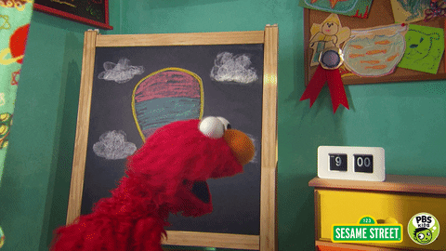
Organizing for separation of concerns

Slide 24

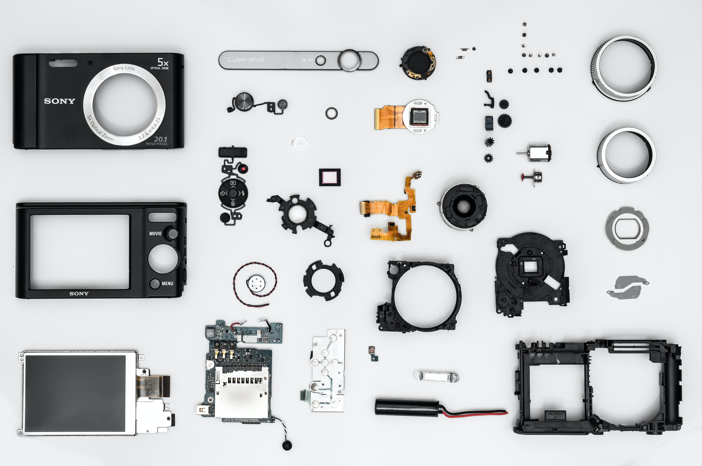
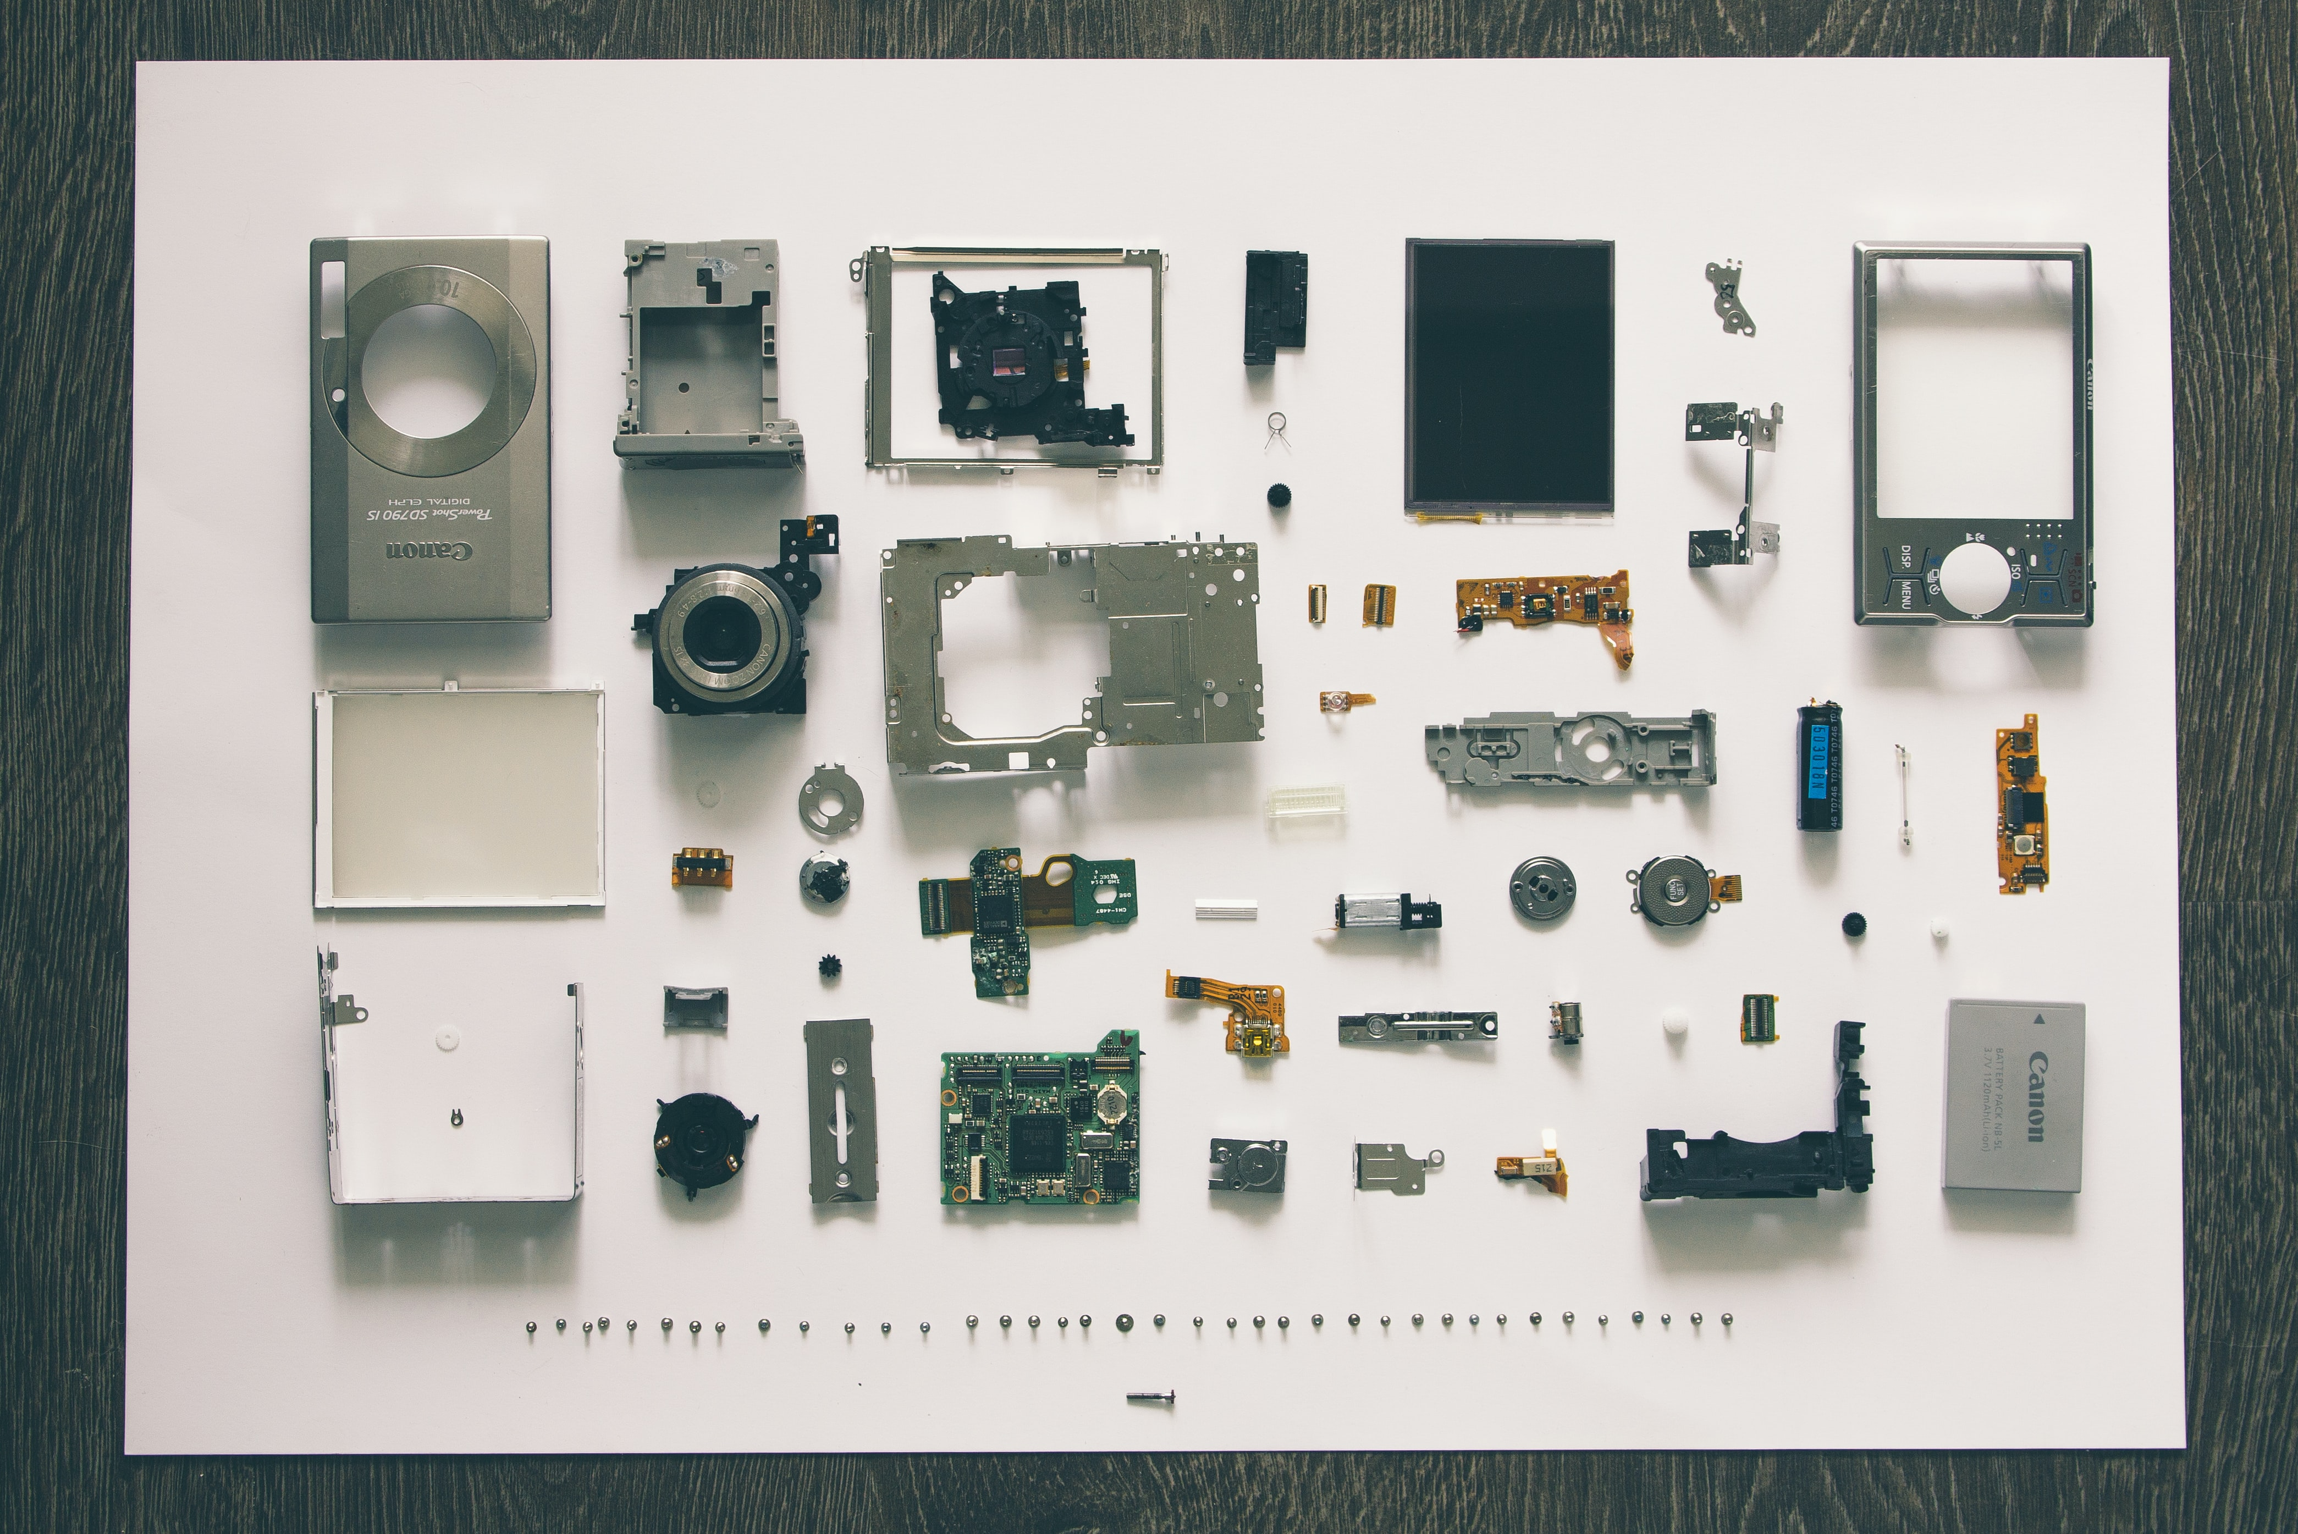
A Tale of organization (1)

Slide 25
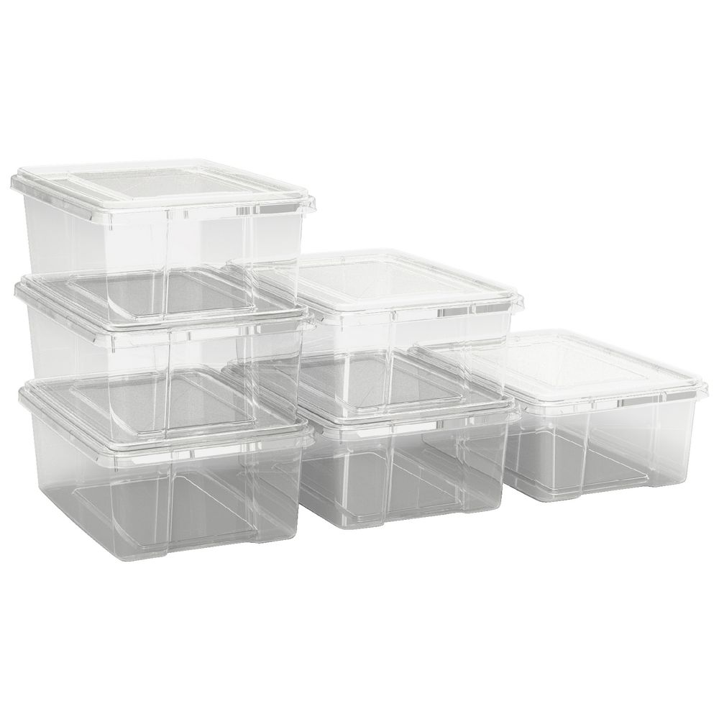

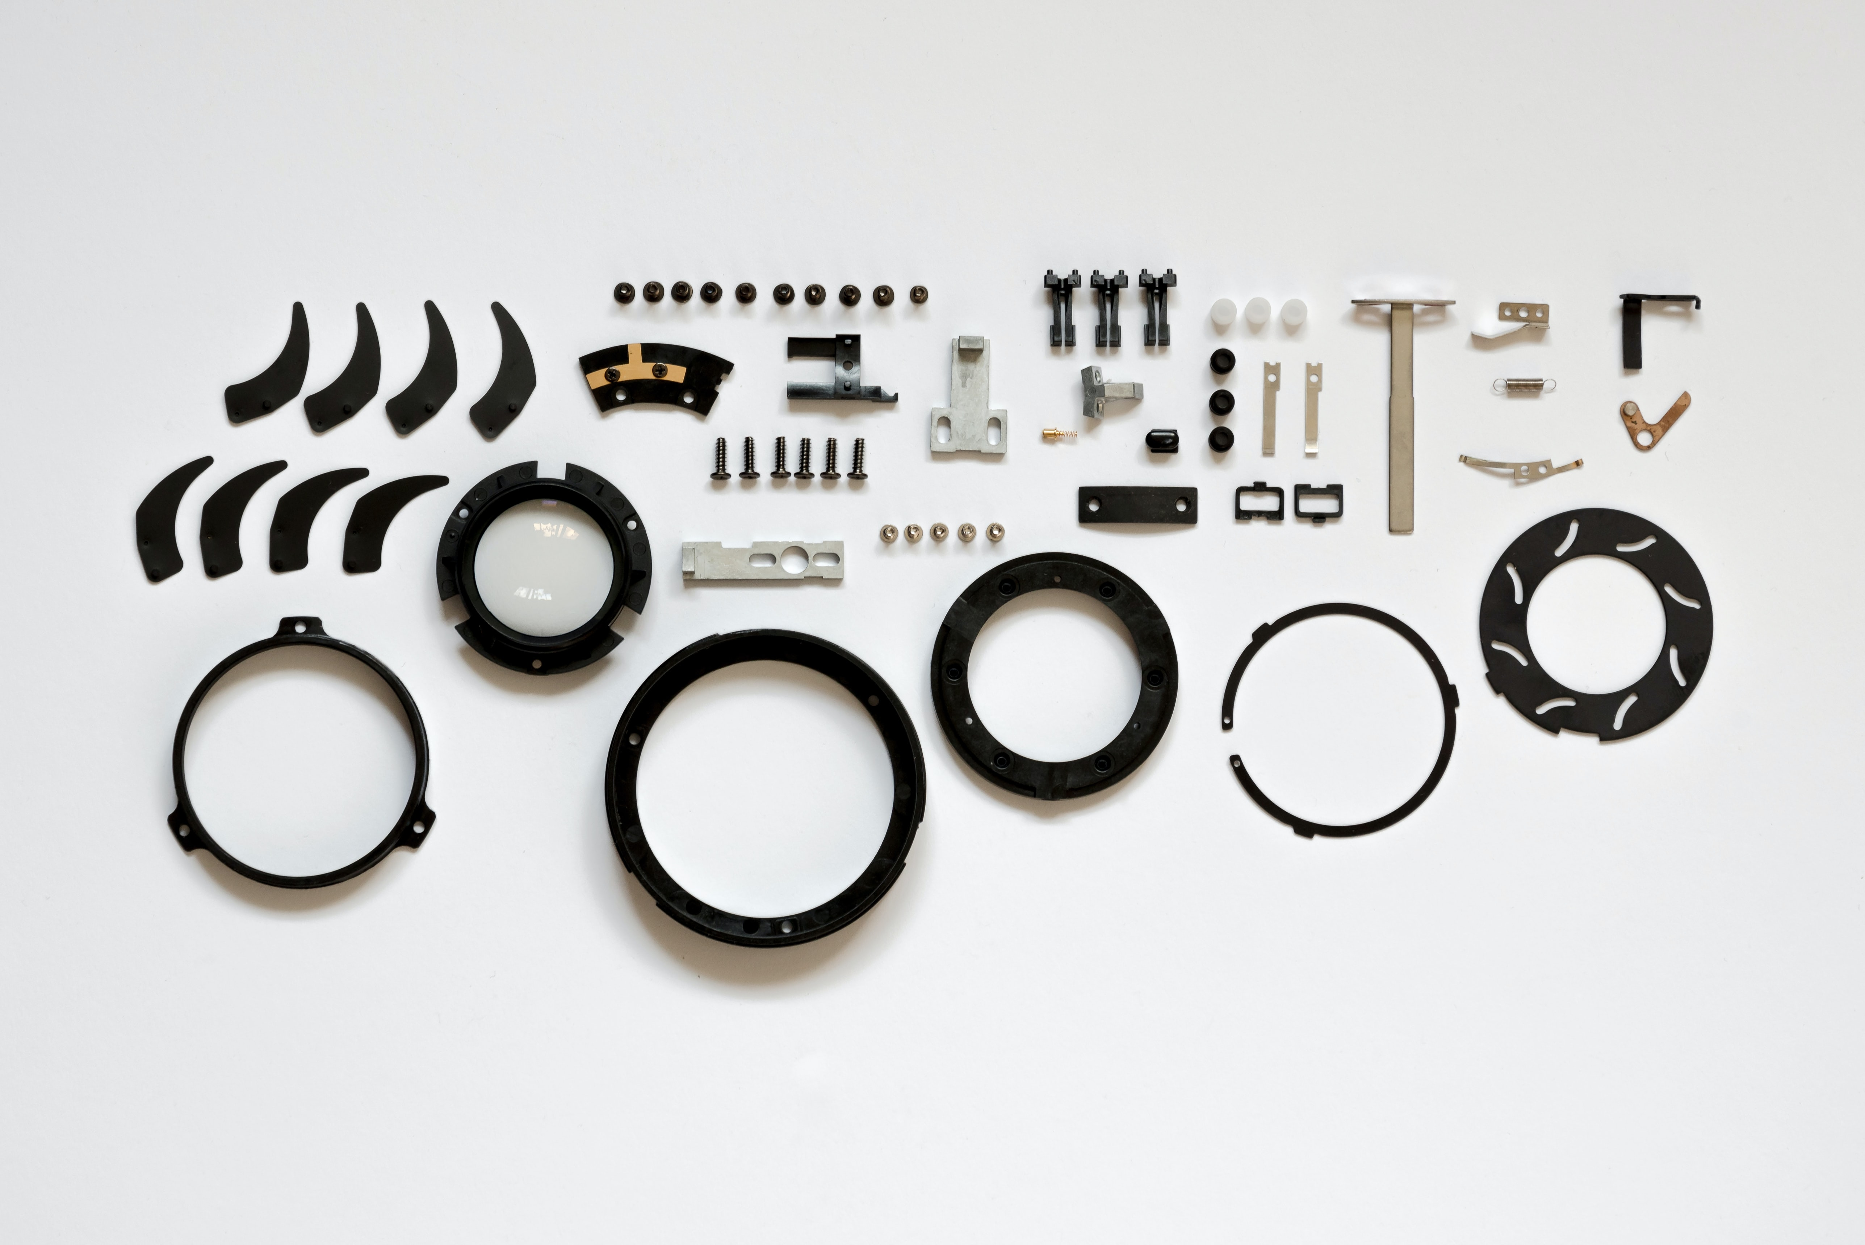
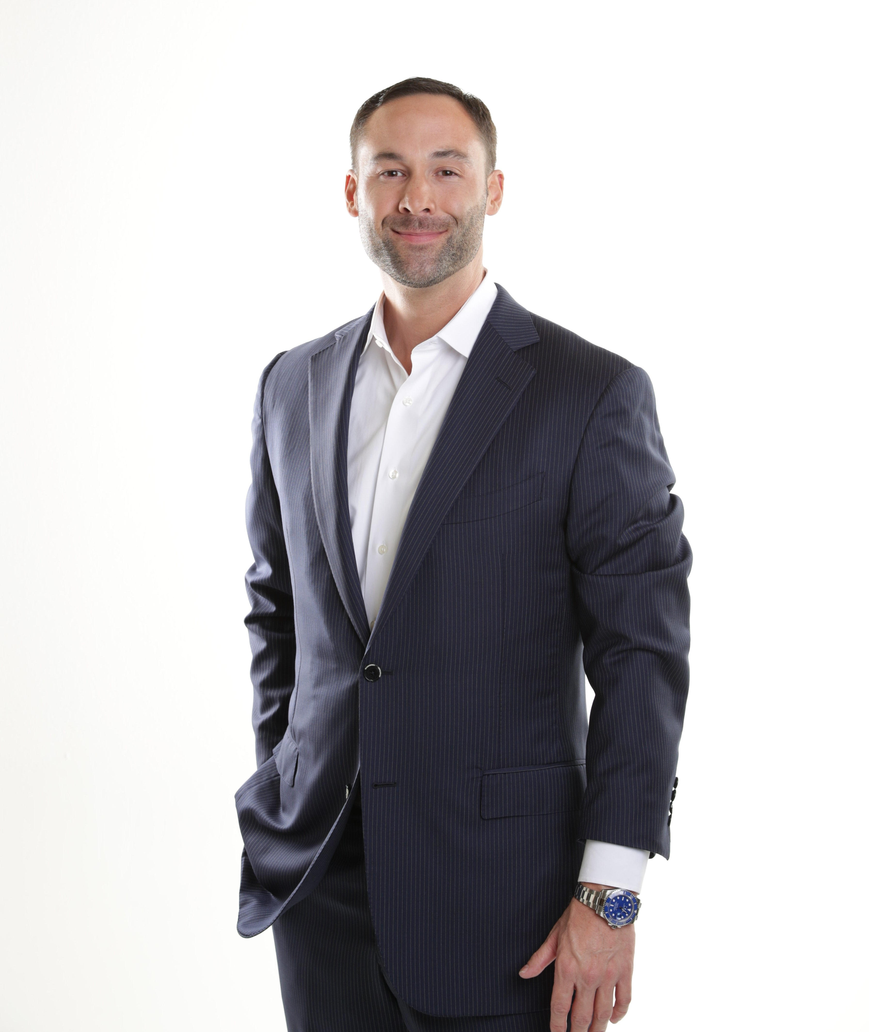
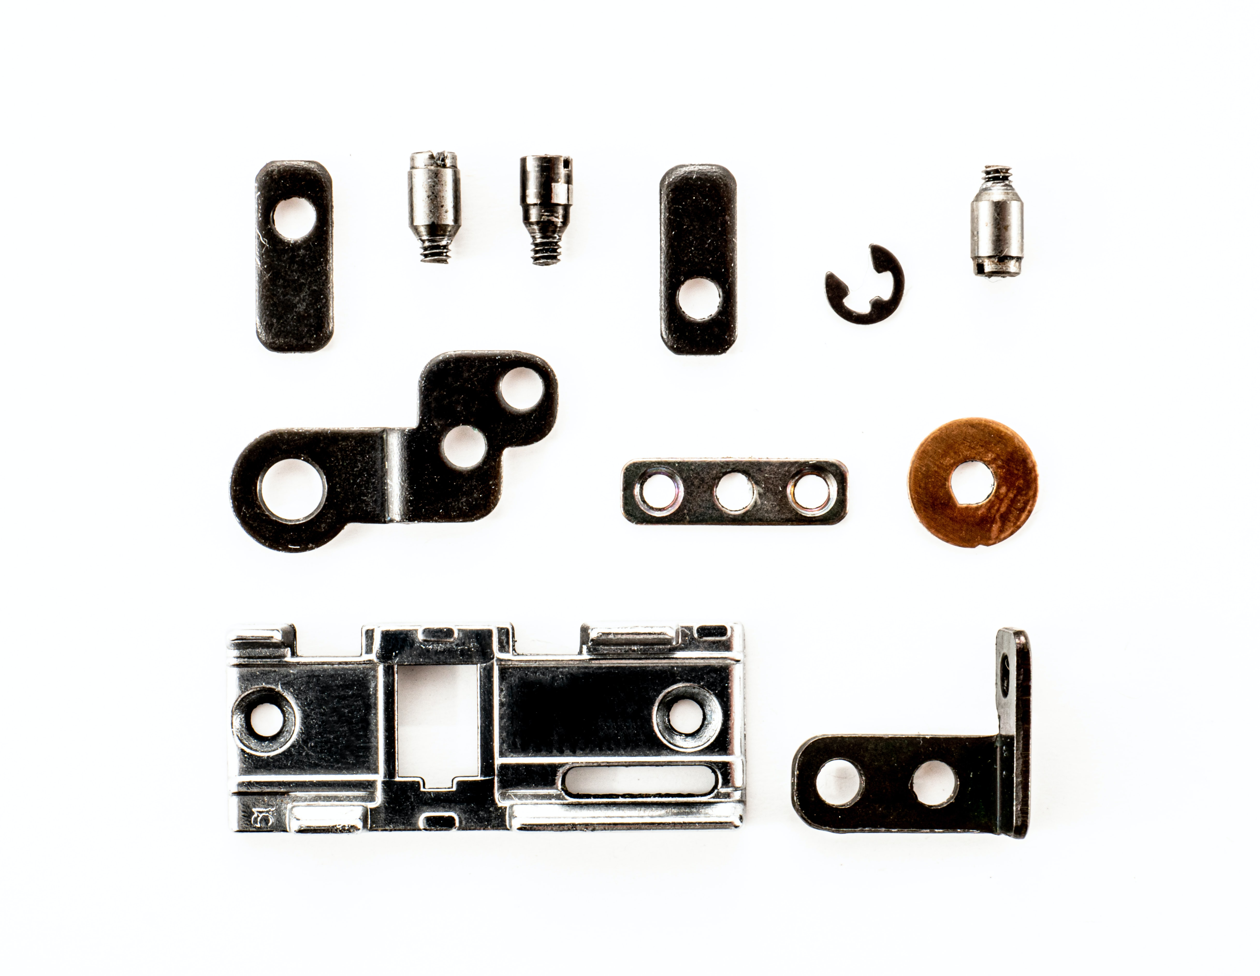

A Tale of organization (2)

Slide 26
Let’s discuss…
Was the assistant's organizational idea bad?
What would be worse?
What would have been better?
Why?
What is the purpose of an Ikea store vs a hardware store and how does this relate.
Which paradigm better resembles an application
When does this guideline not apply

Slide 27
Organizing exercise
Let's do a quick exercise

Slide 28
Fragmentation organization vs Entity organization
Is this architecture fragmented or entity based:
https://github.com/chienvh/ASP.Net-MVC-Entity-Framework-by-Example-Project
https://github.com/saineshwar/WebTimeSheetManagement
https://github.com/justinhartman/complete-php7-ecom-website
https://github.com/KodrAus/rust-web-app

Slide 29

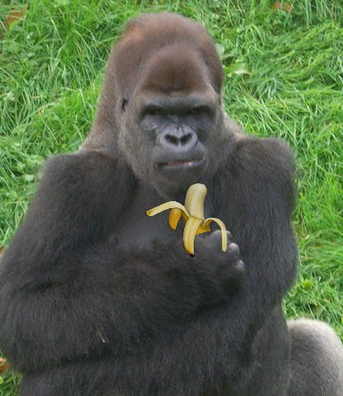

The “TAKE IT AND GO” PRINCIPLE
The easier it is to pick up some code and move it to a different project the better
Fragmented code makes this very hard
Entity based code makes it easier

Slide 30


core principles
Before diving into the code lets look at some core tenents

Slide 31
General principle: express intent!!!!!
This one is KEY!
YOUR CODE SHOULD EXPRESS YOUR INTENT
Express:
directly, firmly, and explicitly stated
(Merriam-webster)
Explicit:
fully revealed or expressed without vagueness, implication, or ambiguity : leaving no question as to meaning or intent
(Merriam-webster)
Intent:
having the mind, attention, or will concentrated on something or some end or purpose
(Merriam-webster)

Slide 32


Code compare: express intent
Code horror
acceptable
int foo(int x, int y)
{
int z = x + y;
return z;
}
int add_2_numbers(int left, int right)
{
int sum = left + right;
return sum;
}

Slide 33

Exercise time: express intent
review:
code-examples\express_intent
Then do:
code-examples\express_intent\express-intent-ex1.c
3 Minutes

Slide 34
General principle: Variable names
Variable names should be meaningful in proportion to their lifetime and scope!
A rule of thumb is, the longer the variable stays alive the better the name needs to describe it and the longer it will be

Slide 35


Code compare: Variable names
Code horror
acceptable
float x;
//...;
void get_temperature()
{
char *w = "some bus id";
float temp = get_value(w);
some_call_2();
some_call_3();
some_call_4();
x = some_call_5(temp);
}
float water_temperature;
...;
void get_temperature()
{
char *id = "some bus id";
float temperature = get_value(id);
some_call_2();
some_call_3();
some_call_4();
water_temperature = some_call_5(temperature);
}

Slide 36
Exercise time: variable names
review:
code-examples\variable_names
Then do:
code-examples\variable_names\variable_names-ex1.c
3 Minutes

Slide 37
General principle: KEEP YOUR SCOPE SMALL
Limit the amount you need to focus on at any given time. This means when reading the code everything related to what you are looking for should be easy to find and to get to.
Don’t make the reader try to remember too much
How???
Declare variables close to where they are needed
Check for error conditions early and exit early.
Minimize nesting
Isolate functions to modules and mark them as static if they are not needed elsewhere
Minimize global variables

Slide 38


Code compare: keep scope small
Code horror
acceptable
esp_err_t divide_2_numbers(int left, int right, float *result)
{
int local_result;
bool is_err;
if (right == 0)
is_err = true;
else
is_err = false;
if (is_err == false)
{
local_result = left / right;
*result = local_result;
return ESP_OK;
}
return ESP_FAIL;
}
esp_err_t divide_2_numbers(int left, int right, float *result)
{
if (right == 0)
return ESP_FAIL;
int local_result = left / right;
*result = local_result;
return ESP_OK;
}

Slide 39
Exercise time: keep scope small
code-examples\keep_scope_small\avoid_nesting .ex1.c
code-examples\keep_scope_small\keep_variable_lifetime_short.ex2.c
3 Minutes

Slide 40
General principle: Keep code compliable
Compile your code often.
Test your code often
Use liberal logging.
Only remove logging once you are confident the code runs correctly

Slide 41
A note on comments
I don’t use comments unless I can’t express my intent. This would usually be because I need to hack something!
So, what's wrong with using comments?
Nothing. This is my personal preference

Slide 42

Structuring code
An evolution to a better system

Slide 43
Code structure and walkthrough
We will now go through creating a project.
On the way we will encounter design principles.
We will redirect focus on how to make these decisions when encountered
The next slide shows the first design principle and it’s in pink
Code exercises are in green
Code choices and decisions are in black
https://github.com/Mair/code-structure/blob/master/main/main.c
Quick orientation of the code

Slide 44
Review: _0_add_idf_lib
Intro to Uncle Rus: https://github.com/UncleRus/esp-idf-lib

Slide 45

Tips for Where to start
Look at what it has
Pick one thing – let’s call it a “module”
Work from main to that module

Slide 46
General principle: Modules
C modules have a c and h file
Stick to the “Take it and go” principle AS MUCH AS POSSIBLE

Slide 47

CODE DECISIoN: Which is better, why?
We need initialize a task for out module. What are the advantages, disadvantages to the below?
//in main.c
void app_main(void)
{
xTaskCreate(measure_...);
}
//in measure_water_temperature.c
void measure_water_temperature_init(void)
{
xTaskCreate(measure_...);
}
Hint: We will discuss leaky abstractions (forcing a module to have a dependency it doesn’t need) later

Slide 48
Review _1-water-temperature-measure

Slide 49
CODE DECISIoN: Which is better, why?
We need to make the temperature available, what’s the best way to do this
//in measure_water_temperature.c
float temperature = 0;
//in measure_water_temperature.h
extern float temperature;
//in measure_water_temperature.c
volatile float temperature = 0;
float get_water_temperature()
{
return temperature;
}
//in measure_water_temperature.h
float get_water_temperature(void);

Slide 50

Review _2-get-water-temperature
Why volatile?

Slide 51
Exercise time: reader pattern
review:
main\water_level\water_level.c
Then:
Do your own reader pattern for the light sensor
3 Minutes

Slide 52
The Cache Pattern
Excellent strategy for reading data periodically and making that reading available to many processes

Slide 53
General principle: COnfig
Unlike most variables, it make sense to keep your application config global
Configs are best contained in a structure
ALWAYS initialise your members of your config with sane defaults if there is nothing in the store
Don’t call your config “config” because there are many configs. You can call it “app_config”
Maintain a copy of the config in memory so its easy and quick to get to
Create a function that updates the config and at the same time updates the copy in memory

Slide 54
We have a dependency on config
We haven’t worked out all the details yet, but we know we need a config. Let’s get started with a config module which will hold our config data in a structure

Slide 55
The APP CONFIG Pattern
You can use any persistent store (FAT, SPIFFS, SD CARD, etc) however, keeping application config in NVS allows you to later encrypt it which is useful for passwords, keys etc.
Keep application config light and easily accessible. No crazy arrays, linked lists etc. No heavy blobs etc.
App config differs from sdkconfig. When to use what and why? Let’s discuss
Config patterns break other patterns! But their benefits outweigh any issues

Slide 56
CODE DECISIoN: Which is better, why?
//in app_congig.h
typedef struct config_app_t {
int water_measure_temperature_intervale;
}config_app_t;
We need to create a structure for our config. Let’s review structure composition
//in measure_water_temperature.c
typedef struct water_measure_t {
int temperature_intervale;
}water_measure_t;
typedef struct config_app_t {
water_measure_t water_measure;
}config_app_t;

Slide 57
Exercise time: STRUCTURE COMPOSITION
review:
code-examples\structure-composition
Then do:
code-examples\structure-composition\structure-composition-ex1.c
Question:
Could the same principle apply to folders?
3 Minutes

Slide 58
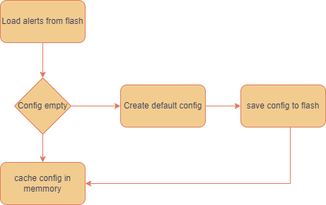
Review: _3-start-config-module
Why use NVS lets discuss options…

Slide 59
The Air temperature is very similar to water temperature. Let’s do that next

Slide 60
Review: _4_air-temperature
What’s wrong with this code?

Slide 61
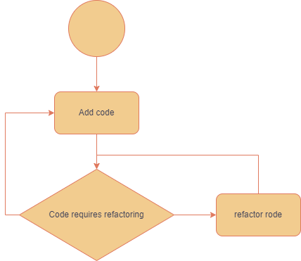

What’s wrong: Its time to refactor
We have a lot of duplicated code
File and folder composition

Slide 62
General principle: Folder composition
Folder composition is the result of organically grouping common things
Folder composition can be hierarchical
Refer back to our story about the photographer.
Folders should represent groups of things
sensor
water
depth
temperature
Alerts
Failure
Water pump
Air pump

Slide 63
Review: _5_air-temprature-folder-composition

Slide 64
General principle: DRY (DON’T REPEAT YOURSELF)
Isolate common functions and move them into their own modules
If you have a lot of isolated modules, merge them into a utility module
The “Take it and go” method is especially relevant to isolated and utility modules
If there is a choice between DRY and readability err on the side of readability

Slide 65
Review: _6_air-temprature-refactor-1

Slide 66
Should we consolidate air and water tasks?
Why and why not. Advantages and disadvantages lets discuss…

Slide 67
Review:_7_air-temperature-refactor-2

Slide 68
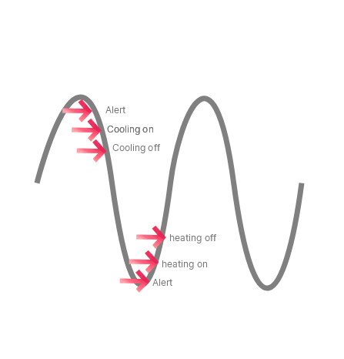
Review: _8_temprature_control_assets

Slide 69
What about DRY?
Cooler and heater look very similar: should we refactor it? Why or why not?
Did you notice the water_control module? What are its benefits?

Slide 70
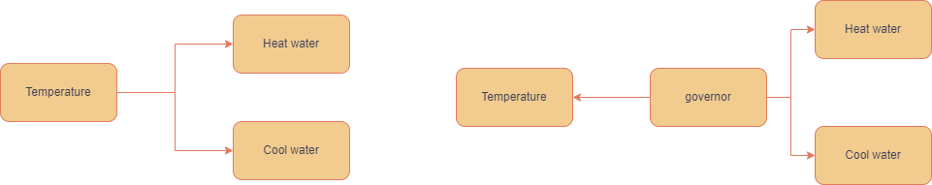
CODE DECISIoN: Which is better, why?
We need to create alerts if the water temperature goes extreme. Which is better? Plus and minus points
Checking the temperature in the temperature module and adjusting control and sending the alert if extreme temperatures are hit
Creating a module dedicated to controlling and monitoring thresholds checking values periodically. Sending alerts and adjusting controls if thresholds are hit

Slide 71
The Governor Pattern
Single point of control
Couples multiple modules together without needing to change them
Works very will with the reader pattern

Slide 72
Review: _9_the_governor
Let’s implement the governor pattern

Slide 73
Let’s create an Alert and task to it with fREERTOS

Slide 74
General principle: Most common FREERTOS functions
Use a binary semaphore to indicate a state of change
Use an event for state polling or multiple states
Use a queue to send data
Use a mutex to lock a resource

Slide 75
General principle: USE STRUCTURES WHEN TRANSFERRING PAYLOAD
Even if you only need to send 1 byte wrap it in a structure. This makes transferring data
Consistent
Extendable
Easy to move from function to function

Slide 76
Let’s see a queue while working with alerts
Use structures when working with communications!

Slide 77
Review: _10_alerts
Now let’s get a real alert notification

Slide 78
11_alerts_with_slack
Wifi
Slack api

Slide 79
Did you notice
We dropped WI-Fi in as a dependency (from the course)… Take it and go

Slide 80
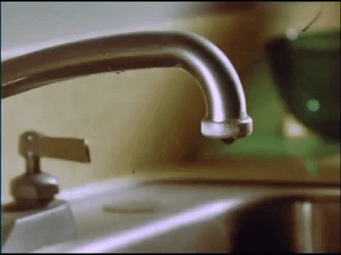
Leaky abstractions
The last piece of code works but there is a slight problem…
The Governor is forced to have FreeRTOS and a queue as a dependency even though it doesn’t need it
This is known as a leaky abstraction: Forcing code to have dependencies just so that it can interact with other dependencies.

Slide 81
General principle: Avoid leaky abstractions
Isolate the dependencies to modules who own it.

Slide 82
Logging our data
We start off with initializing the SD card which is mostly boiler plate
We need to log out data, however the data will be meaningless unless we put a date on it. Let’s do that now
We create a function to write data to the SD card

Slide 83

Review: _13_sd_card_and_sntp
Did you notice that we return a string? When is this OK. When is it not OK

Slide 84
CODE DECISIoN: Which is better, why?
We need to store data. How should we store it? When is it best to use the below strategy?
Binary
JSON
CSV
XML

Slide 85
Review: _14_sd_card_log
Why would we use an event queue to see if the time has been set and not a semaphore?

Slide 86
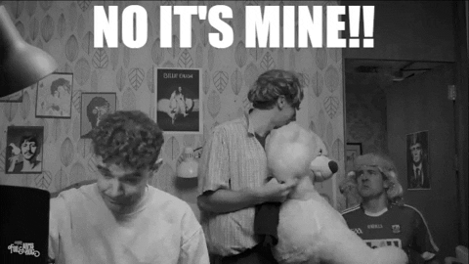
General principle: Lock resources with a mutex
Things can go wrong if multiple tasks try to access a non thread safe resource at the same time.
To avoid this, use a mutex lock

Slide 87
Review: _14_sd_card_log
Did you notice we release the semaphore if we can’t open the file? What would happen if we didn’t?

